Slide 1
Instagram Data Analytics
SQL Fundementals

Slide 2
Introduction
Instagram User Analytics project using MySQL workbench to draw useful insights

Slide 3
Project Focus
The goal of this project is to analyzing user interactions and engagement with the instagram app to provide valuable insights that can help the business grow. User analysis involves tracking how users engage with a digital product, such as a software application or a mobile app. The insights derived from this analysis can be used by various teams within the business. For example, the marketing team might use these insights to launch a new campaign, the product team might use them to decide on new features to build, and the development team might use them to improve the overall user experience. In this project, i’ll be using SQL and mysql workbench as the tool to analyze instagram user data and answer questions posed by the management team. My insights will help the product manager and the rest of the team make informed decisions about the future direction of the instagram app.

Slide 4
Approach
Database creation: Created and inserted the values in the database using the DDL & DML SQL queries provided by the project manager in the MySQL database using MySQL workbench
Extraction of Insights: After creating a database required insights are generated from database by running SQL queries in MySQL workbench
Tech-stack used
Used MySQL server 8.0.44 and MySQL Workbench version 8.0.34 3263449 CE (64 bit)

Slide 5

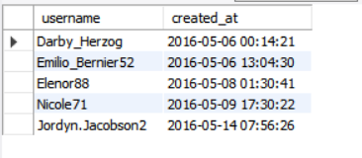
Marketing Metrics :Rewarding the Top 5 loyal customers

Slide 6
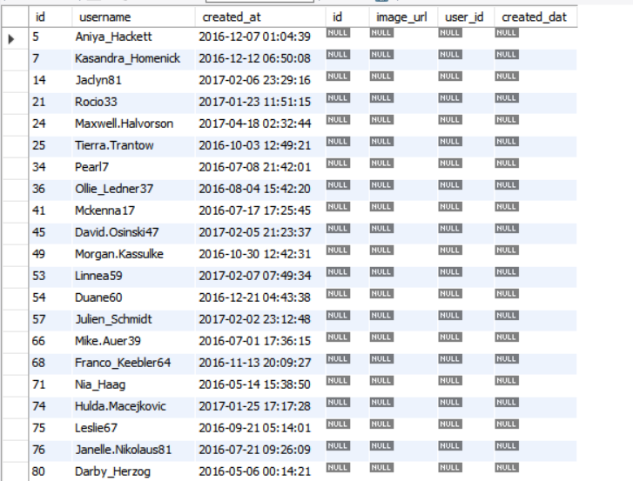
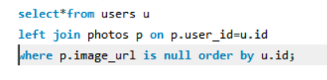
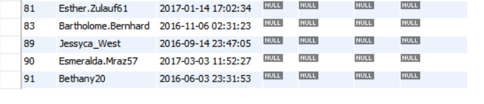
Encourage inactive users by sending promotional emails
Users who have never posted a single photo

Slide 7
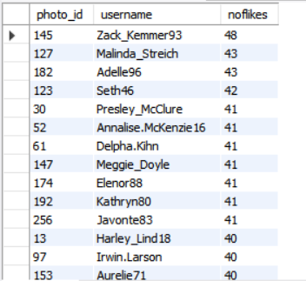
Contest winner : Photo with most likes
Contest Winner is Photo ID 145 and user is Zack_Kemmer93

Slide 8
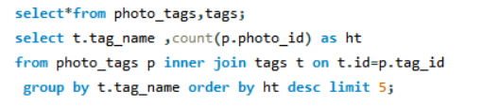
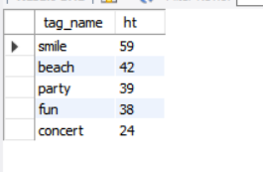
Mostly used hashtag
Most used hashtag is smile

Slide 9
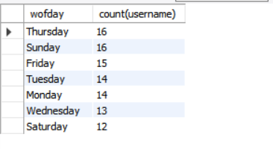

Day of the week most users are active
Users are active mostly on Thursday

Slide 10
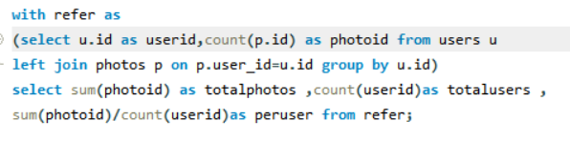
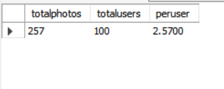
Business metrics :Average photo per user

Slide 11
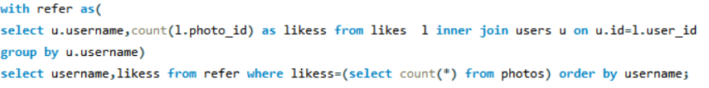
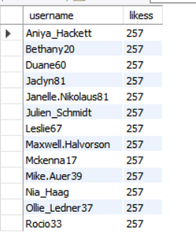
Potential Bots Or Fake Accounts
These are the potential Bots or Fake account

Slide 12
RESULTS
Learnt fundamentals of using sql queries to extract insights from database by which we track how users engage and interact with Instagram usefulin deriving insights for marketing , development and product teams
Conclusions from above analysis
Marketing team can reward most loyal customers to increase user activity
Send promotional emails use popular hashtags and active days for brand promotions
Can increase insights from average photos per user to account for acivity
Fake bots can be removed from the platform to increase user experience

Slide 13
Thank you

